Slide 1
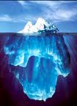

Interior Data Gathering

Slide 2

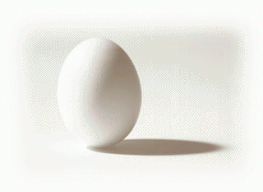

Money History Interview
5

Slide 3
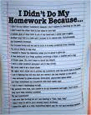
Homework
Money Scripts
Money Egg
Money Atom

Slide 4

Money Egg
15

Slide 5
Money Egg Exercise
Draw an egg
Start with earliest money memory. Earning, receiving, giving, borrowing, or saving. Times someone financially hurt, betrayed, abused, neglected, or took advantage of you
Start at the bottom of the egg
Drawing segments to represent each incident
Progress from past to present
Use your non-dominate hand
15

Slide 6
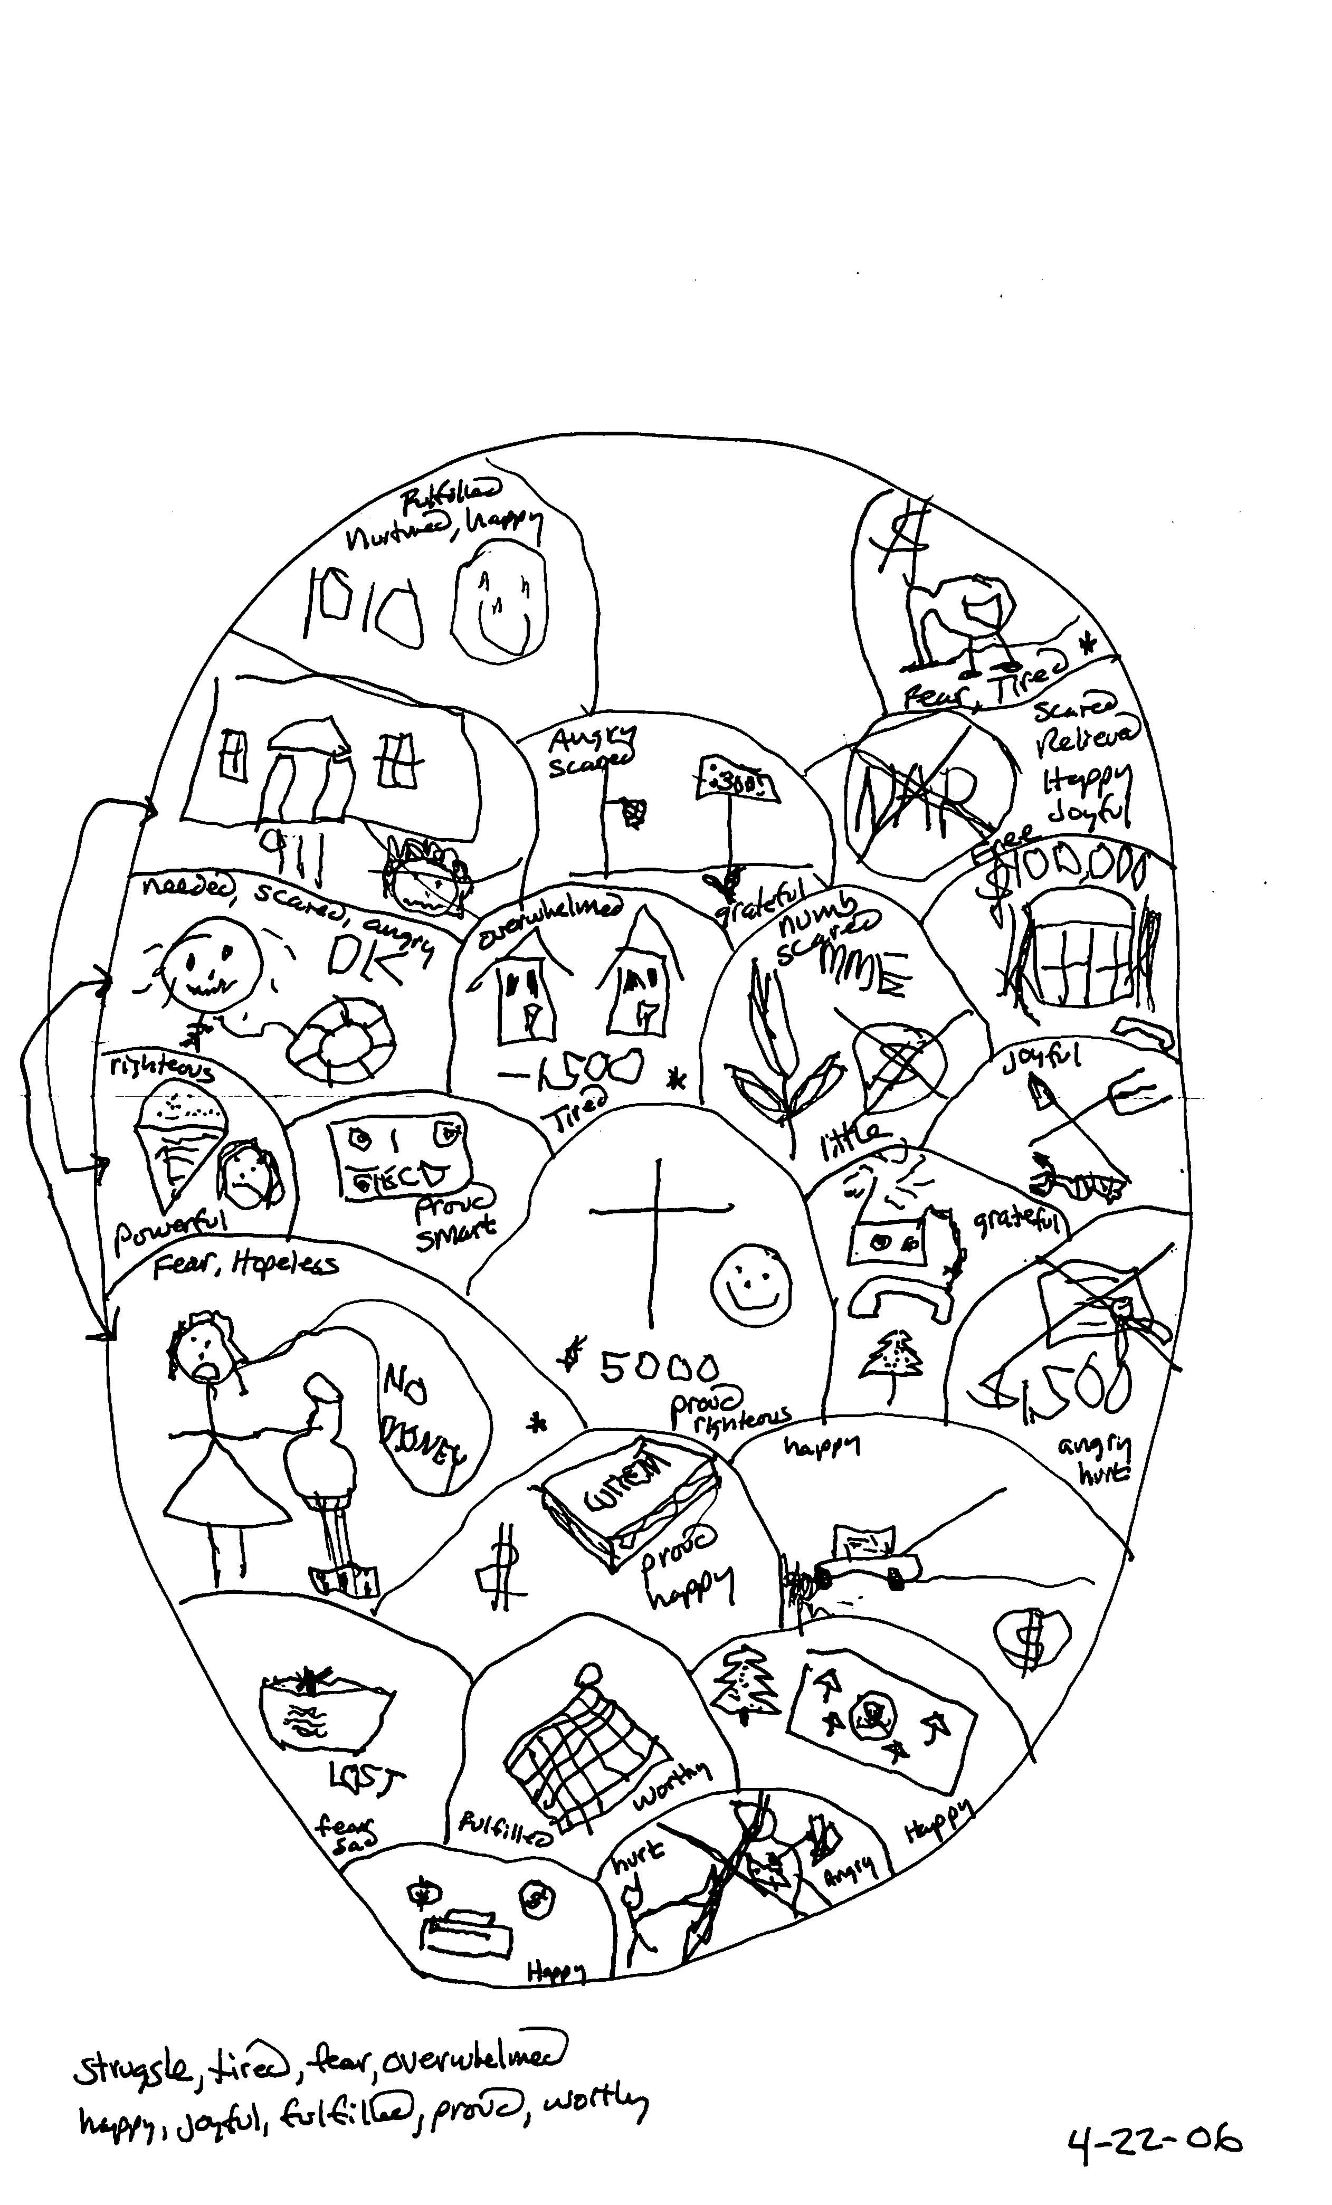
My Egg
19

Slide 7
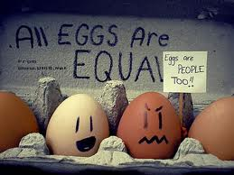
Draw Your Egg
20

Slide 8
Money Egg Exercise
Draw an egg
Start with earliest money memory. Earning, receiving, giving, borrowing, or saving. Times someone financially hurt, betrayed, abused, neglected, or took advantage of you
Start at the bottom of the egg
Drawing segments to represent each incident
Progress from past to present
Use your non-dominate hand
20

Slide 9
Money Egg Exercise
Use your dominate hand and go back and attach a feeling to each incident
Put a “-” or a “+” by each event, add up, ratio
Identify the top three positive and negative events
What are the themes or the moral of the story?
Are there any symbols you’ve forgotten?
  Result of disassociation due to trauma.
30

Slide 10
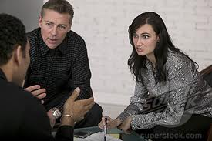
Share Your Story
35

Slide 11
Emotional Listening
Break into groups of two
Each of you will have 5 minutes to tell your story
Switch after 5 minutes
Listeners: no advice, relating to, or opinions
If you must talk; “Tell me more about…”
35

Slide 12
Q & A
50

Slide 13
Rick Kahler
MS, CFP, ChFC
www.KahlerFinancial.com
Rick@KahlerFinancial.com
866-521-1400

